Slide 1
Software Engineering Practice Week 3

Slide 2
SEP Course Sequence
Workshop 2 : Analysis , planning and architecture :
Iteration 0 –Release 1 . Duration 1 week - Group Name: SEP-Wrk-02-Gxx
Workshop 3 : Design , Implementation and testing :
Iteration 1 –Release 1 . Duration 1 week - Group Name: SEP-Wrk-03-Gxx
Workshop 4 : Design , Implementation and testing :
Iteration 2 –Release 1 . Duration 1 week - Group Name: SEP-Wrk-04-Gxx
Workshop 5 : Design , Implementation and testing:
Iteration 3 –Release 1 . Duration 1 week - Group Name: SEP-Wrk-05-Gxx
Workshop 6 : Showcase 1 (30%) 25% Documentation +5% Prototype (Deployed on Cloud / Laptop)

Slide 3
SEP Course Sequence
Workshop 7 : Design , Implementation , testing :
Iteration 1 –Release 2 . Duration 1 week - Group Name: SEP-Wrk-07-Gxx
Workshop 8 : Design , Implementation and testing :
Iteration 2 –Release 2 . Duration 1 week - Group Name: SEP-Wrk-08-Gxx
Workshop 9 : Design , Implementation and testing :
Iteration 3 –Release 2 . Duration 1 week - Group Name: SEP-Wrk-09-Gxx
Workshop 10 : Design , Implementation and testing :
Iteration 4 –Release 2 . Duration 1 week - Group Name: SEP-Wrk-10-Gxx
Workshop 11 : Design , Implementation and testing and deployment :
Iteration 5 –Release 2 . Duration 1 week - Group Name: SEP-Wrk-11-Gxx
Workshop 12 : Showcase 2 (60%)(marks for Each Stand up Meeting from Week7 to Week 11)- Deployed on Cloud

Slide 4
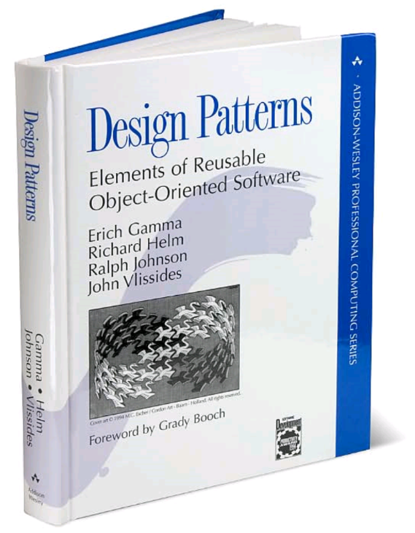

1-UML Foundation
2-Design Pattern

Slide 5

3-Oject Oriented Principals
4-J2ee Design Pattern

Slide 6
UML Foundation

Slide 7
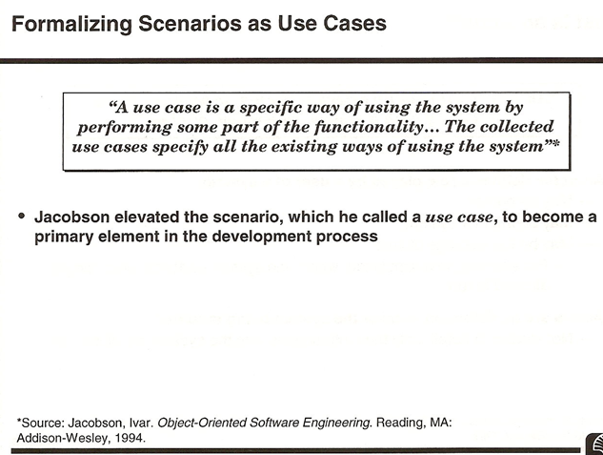

Slide 8
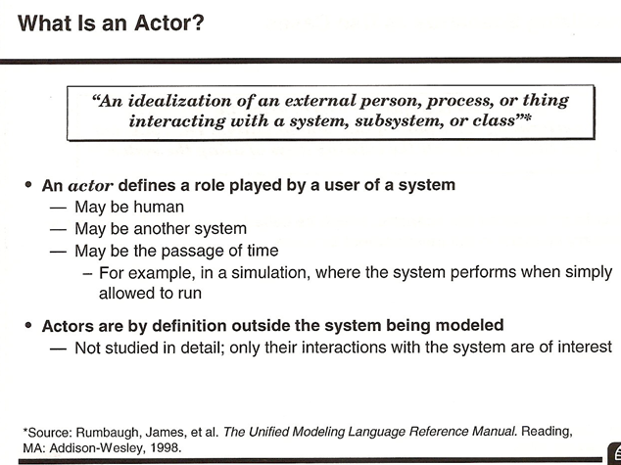

Slide 9
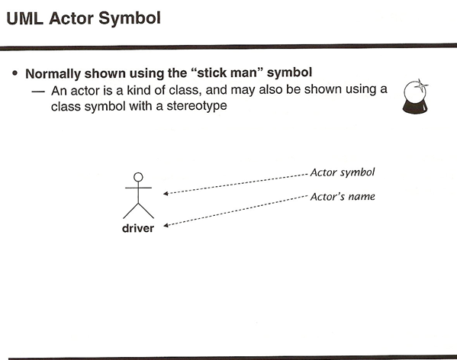

Slide 10
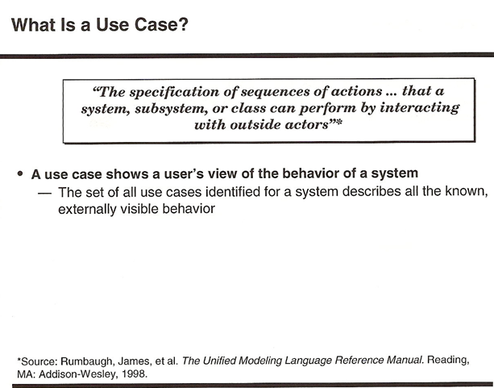

Slide 11
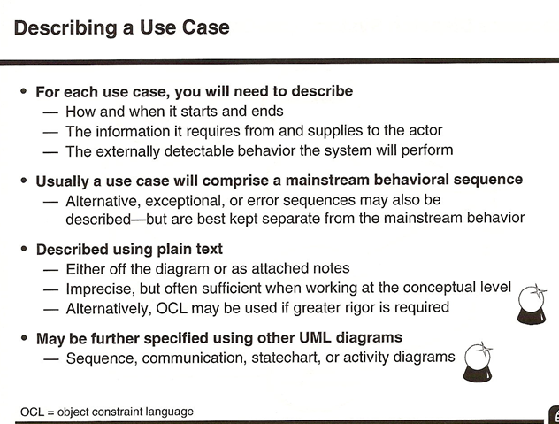

Slide 12
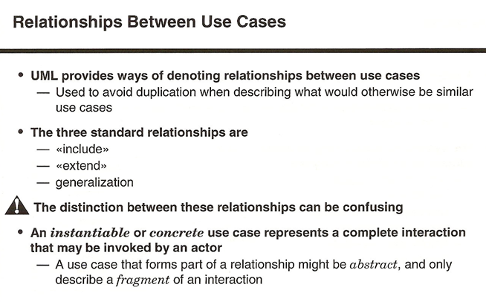

Slide 13
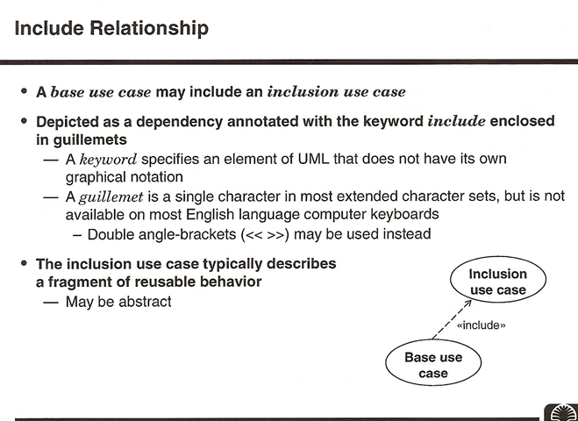

Slide 14
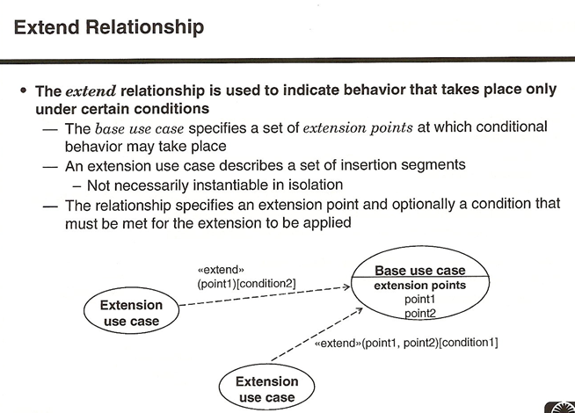

Slide 15
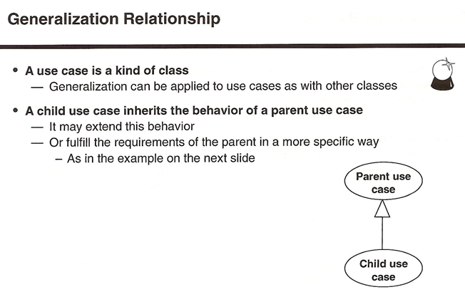

Slide 16
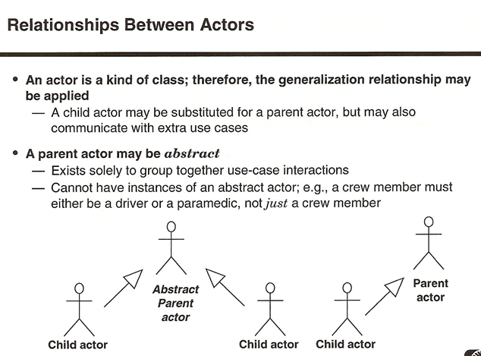

Slide 17
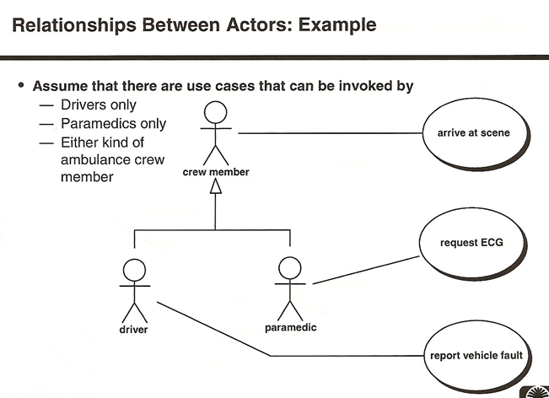

Slide 18
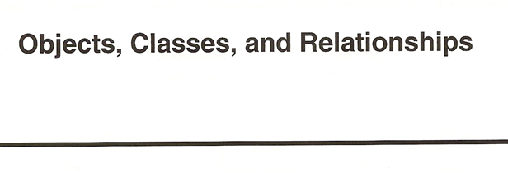

Slide 19
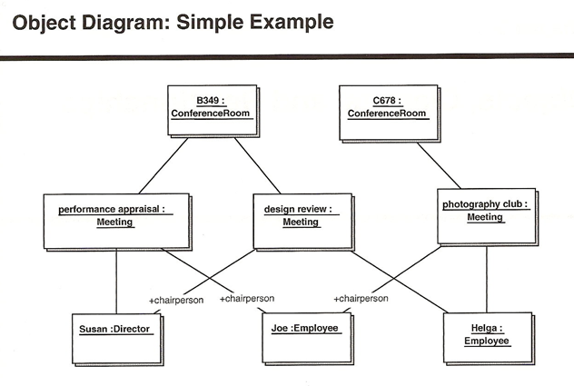

Slide 20
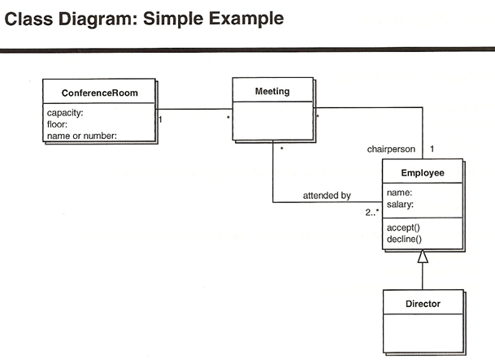

Slide 21
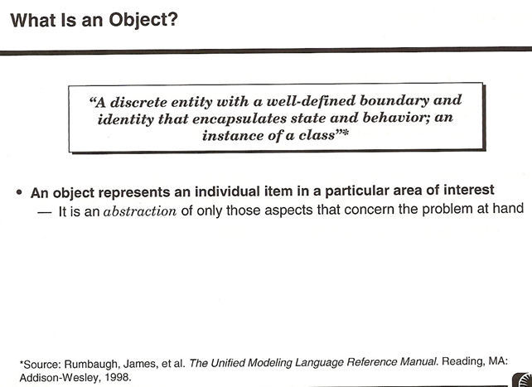

Slide 22
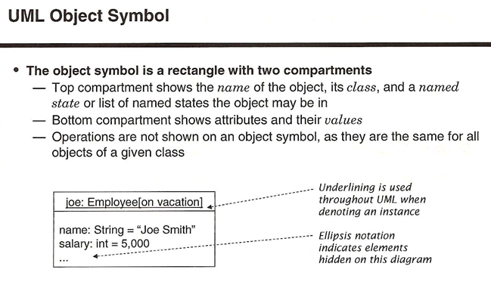

Slide 23
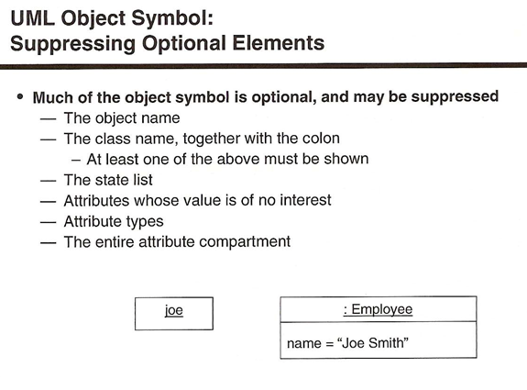

Slide 24
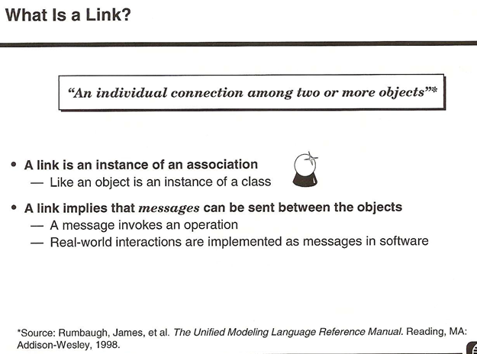

Slide 25
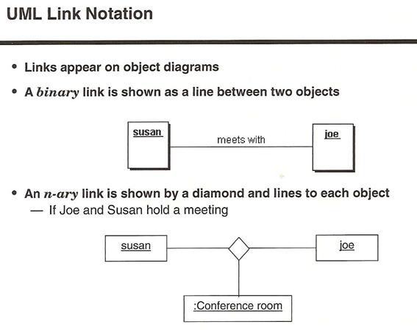

Slide 26
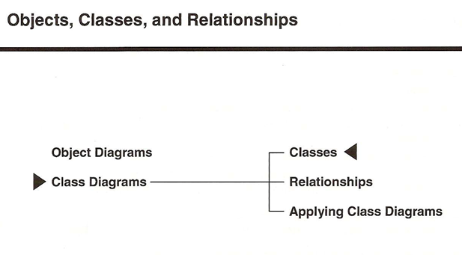

Slide 27
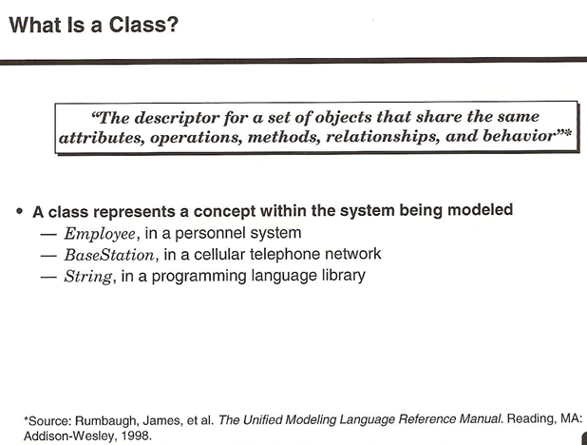

Slide 28
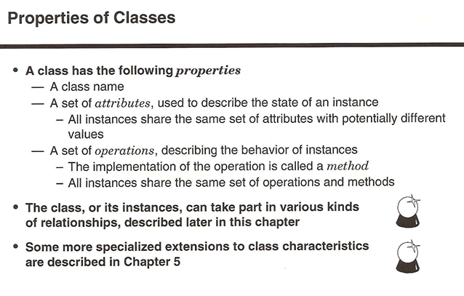

Slide 29
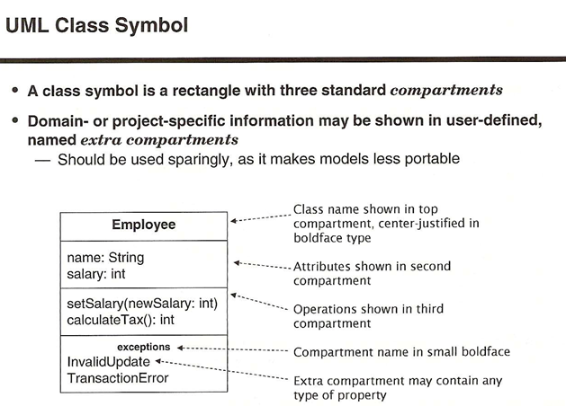

Slide 30
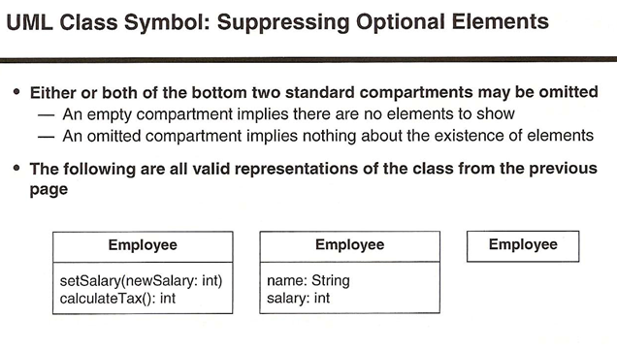

Slide 31
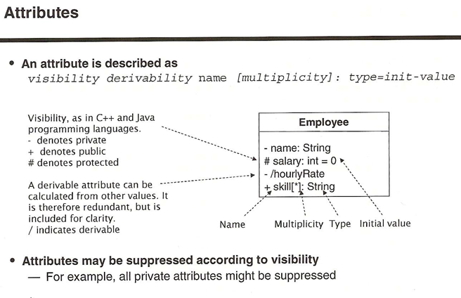

Slide 32
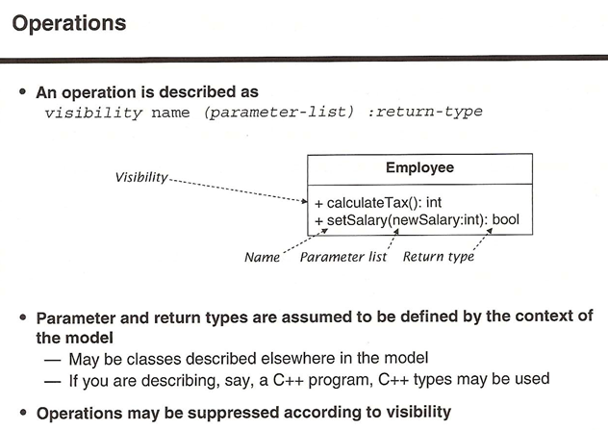

Slide 33
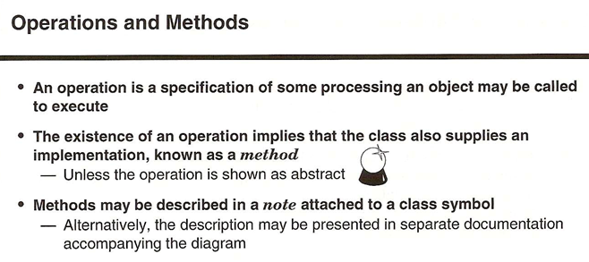

Slide 34
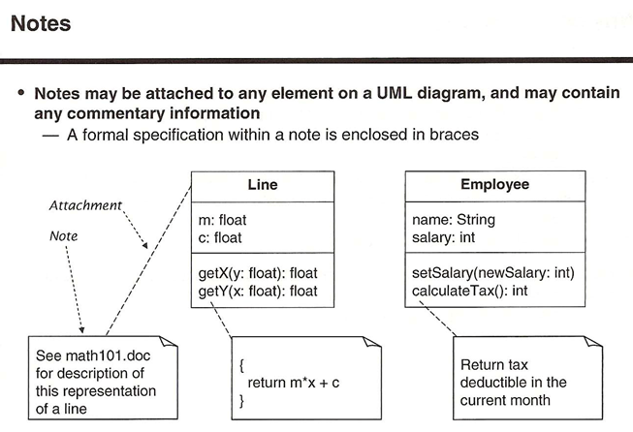

Slide 35
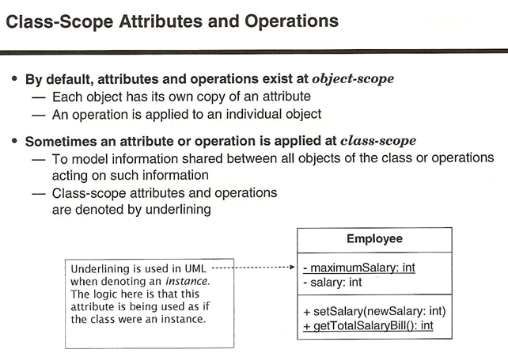

Slide 36
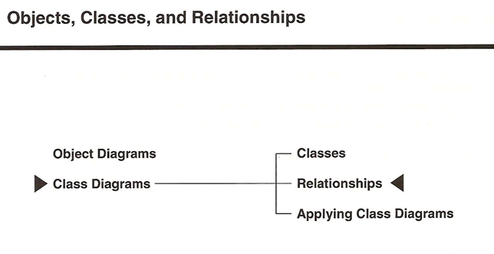

Slide 37
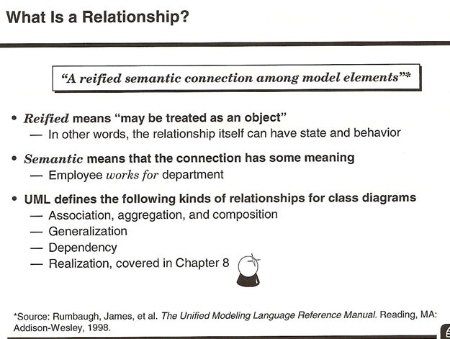

Slide 38
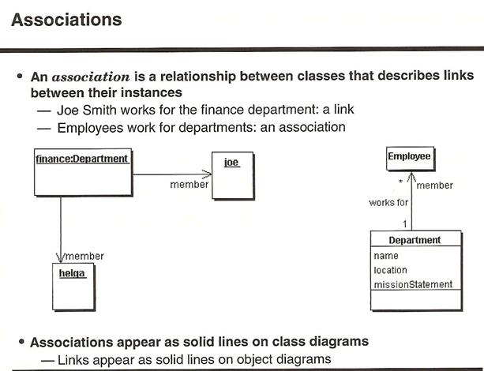

Slide 39
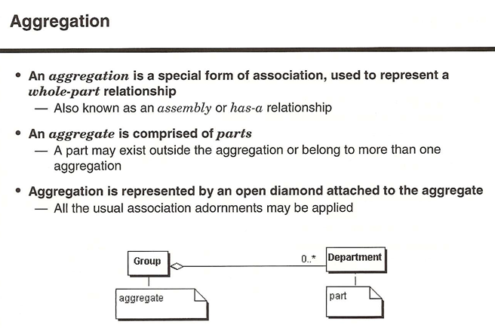

Slide 40
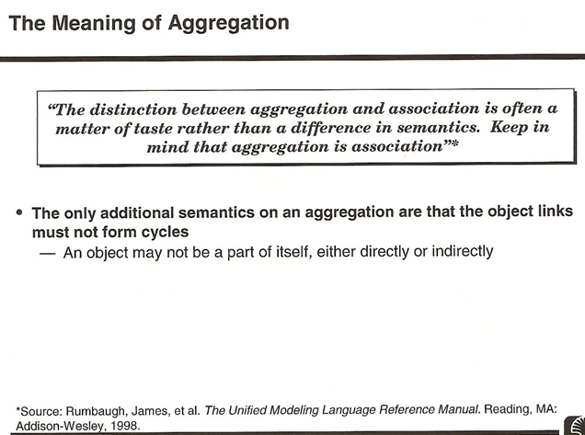

Slide 41
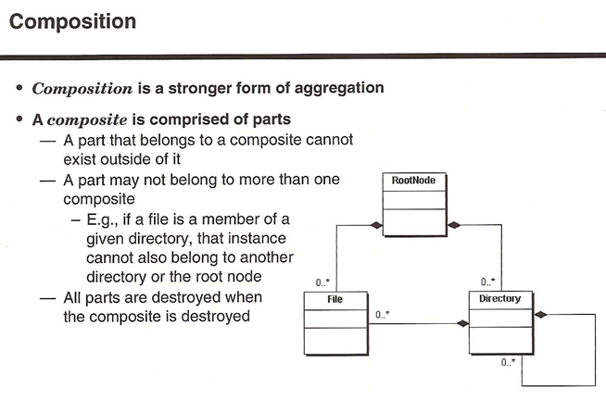

Slide 42
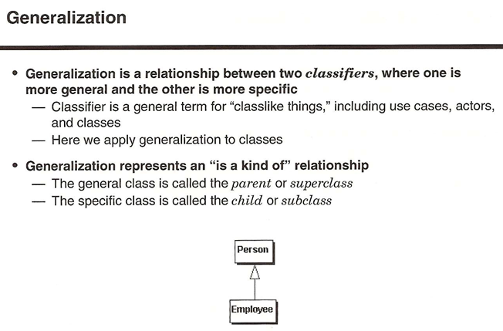

Slide 43
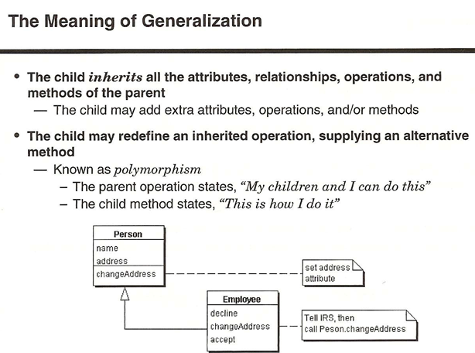

Slide 44
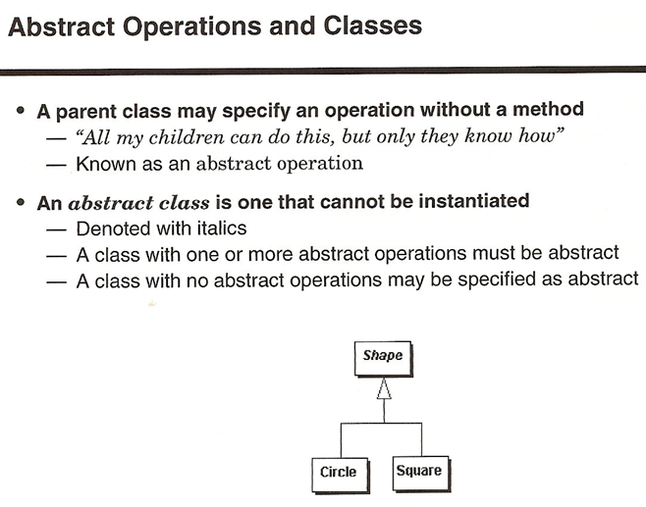

Slide 45
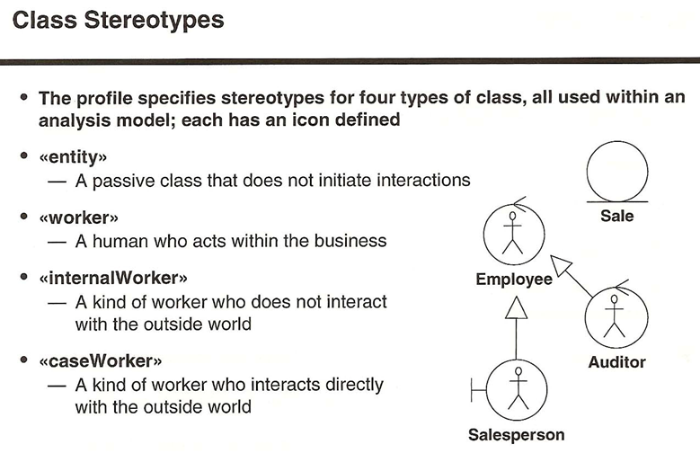

Slide 46
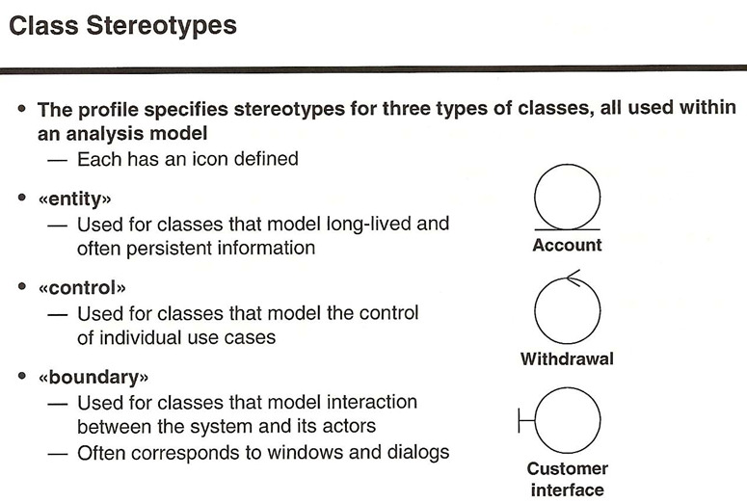

Slide 47
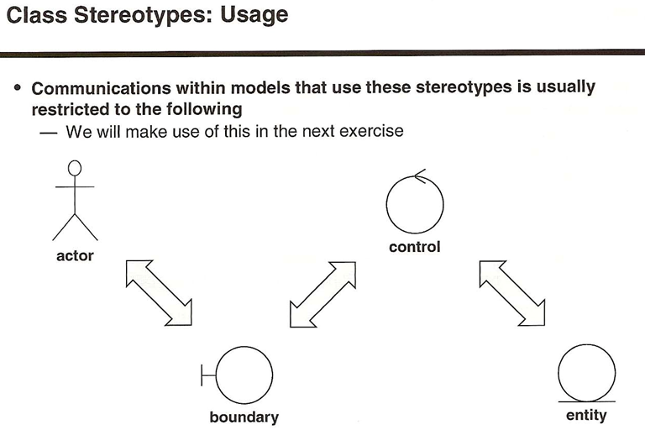

Slide 48
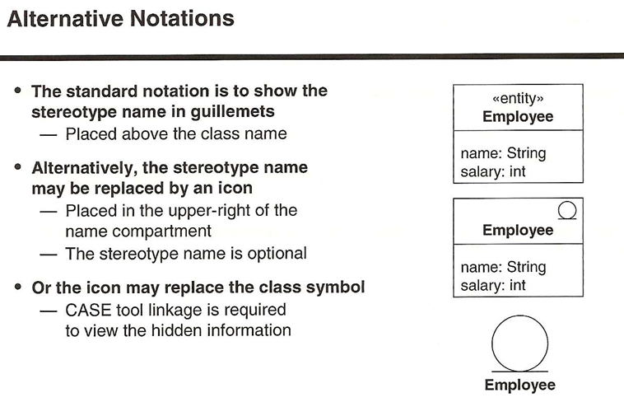

Slide 49
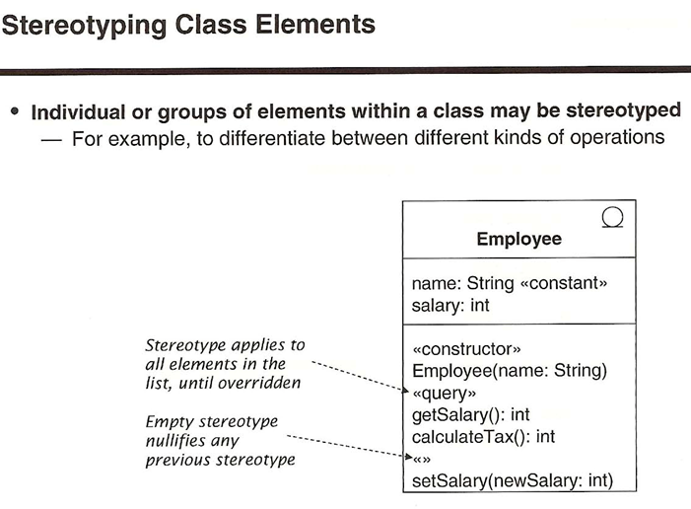

Slide 50
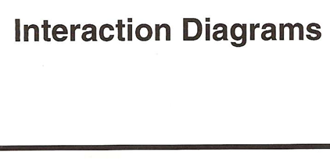

Slide 51
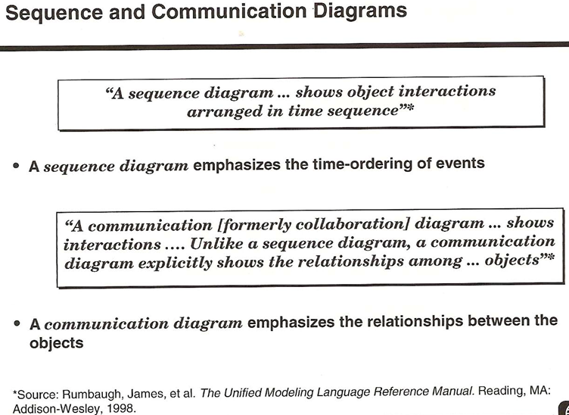

Slide 52
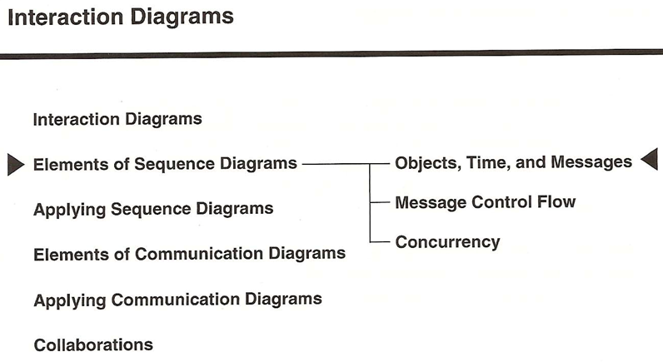

Slide 53
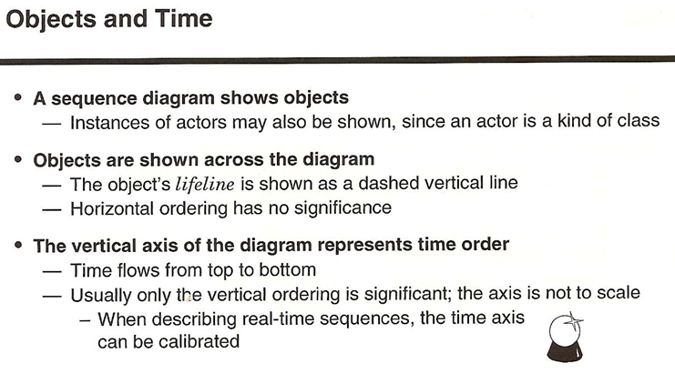

Slide 54
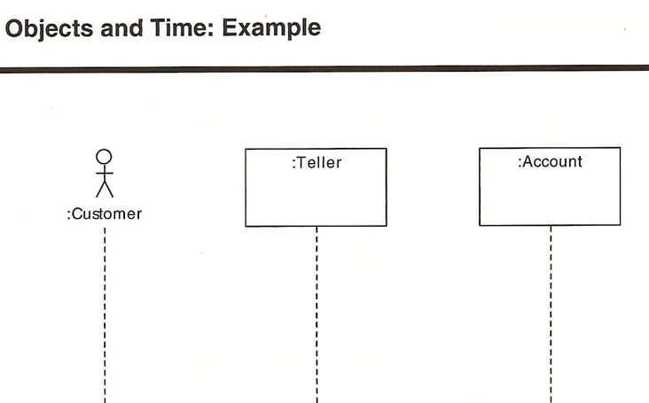

Slide 55
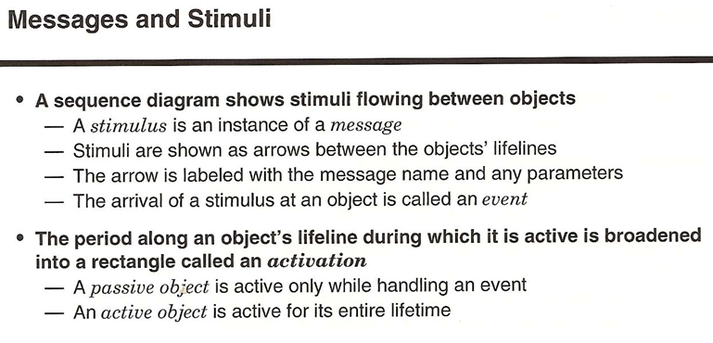

Slide 56


Slide 57


Slide 58


Slide 59


Slide 60


Slide 61



Slide 62



Slide 63


Slide 64


Slide 65


Slide 66


Slide 67


Slide 68


Slide 69


Slide 70



Slide 71


Slide 72


Slide 73


Slide 74


Slide 75


Slide 76



Slide 77



Slide 78


Slide 79
Design Pattern

Slide 80


Slide 81
Creational Patterns
1. Abstract factory
2. Builder
3. Factory method
4. Prototype
5. Singleton

Slide 82

Abstract factory
factory of factories
Intent – Allow creation of families of related objects independent of implementation

Slide 83
enum CarType{MICRO, MINI, LUXURY} abstract class Car { Car(CarType model, Location location) { this.model = model; this.location = location; } abstract void construct(); CarType model = null; Location location = null; CarType getModel(){ return model; } void setModel(CarType model){ this.model = model; } Location getLocation(){ return location; } void setLocation(Location location) { this.location = location; } @Override public String toString() { return "CarModel - "+model + " located in "+location; }}

Slide 84
class LuxuryCar extends Car{ LuxuryCar(Location location) { super(CarType.LUXURY, location); construct(); } @Override protected void construct() { System.out.println("Connecting to luxury car"); }}
class MicroCar extends Car{ MicroCar(Location location) { super(CarType.MICRO, location); construct(); } @Override protected void construct() { System.out.println("Connecting to Micro Car "); }}

Slide 85
class MiniCar extends Car{ MiniCar(Location location) { super(CarType.MINI,location ); construct(); } @Override void construct() { System.out.println("Connecting to Mini car"); }}
class INDIACarFactory{ static Car buildCar(CarType model) { Car car = null; switch (model) { case MICRO: car = new MicroCar(Location.INDIA); break; case MINI: car = new MiniCar(Location.INDIA); break; case LUXURY: car = new LuxuryCar(Location.INDIA); break; default: break; } return car; }}

Slide 86
class USACarFactory{ public static Car buildCar(CarType model) { Car car = null; switch (model) { case MICRO: car = new MicroCar(Location.USA); break; case MINI:car = new MiniCar(Location.USA); break; case LUXURY: car = new LuxuryCar(Location.USA); break; default: break; } return car; }}

Slide 87
class CarFactory{ private CarFactory() {} public static Car buildCar(CarType type) { Car car = null; // We can add any GPS Function here which // read location property somewhere from configuration // and use location specific car factory // Currently I'm just using INDIA as Location Location location = Location.INDIA; switch(location) { case USA: car = USACarFactory.buildCar(type); break; case INDIA: car = INDIACarFactory.buildCar(type); break; default: car = DefaultCarFactory.buildCar(type); } return car; }}
class AbstractDesign { public static void main(String[] args) { System.out.println(CarFactory.buildCar(CarType.MICRO)); System.out.println(CarFactory.buildCar(CarType.MINI)); System.out.println(CarFactory.buildCar(CarType.LUXURY)); }}

Slide 88
Builder
This pattern allows a client object to construct a complex object by specifying only its type and content, being shielded from the details related to the objects representation
The design cover the following
-Too many constructor arguments.
-Incorrect object state.

Slide 89
public class BankAccount { public static class Builder { private long accountNumber; //This is important, so we'll pass it to the constructor. private String owner; private String branch; private double balance; private double interestRate; public Builder(long accountNumber) { this.accountNumber = accountNumber; } public Builder withOwner(String owner){ this.owner = owner; return this; //By returning the builder each time, we can create a fluent interface. } public Builder atBranch(String branch){ this.branch = branch; return this; } public Builder openingBalance(double balance){ this.balance = balance; return this; } public Builder atRate(double interestRate){ this.interestRate = interestRate; return this; } public BankAccount build(){ //Here we create the actual bank account object, which is always in a fully initialised state when it's returned. BankAccount account = new BankAccount(); //Since the builder is in the BankAccount class, we can invoke its private constructor. account.accountNumber = this.accountNumber; account.owner = this.owner; account.branch = this.branch; account.balance = this.balance; account.interestRate = this.interestRate; return account; } } //Fields omitted for brevity. private BankAccount() { //Constructor is now private. } //Getters and setters omitted for brevity. }

Slide 90
BankAccount account = new BankAccount.Builder(1234L) .withOwner("Marge") .atBranch("Springfield") .openingBalance(100) .atRate(2.5) .build(); BankAccount anotherAccount = new BankAccount.Builder(4567L) .withOwner("Homer") .atBranch("Springfield") .openingBalance(100) .atRate(2.5) .build();

Slide 91
Factory Method
In Factory pattern, we create object without exposing the creation logic to client and the client use the same common interface to create new type of object.

Slide 92
public class PC extends Computer { private String ram; private String hdd; private String cpu; public PC(String ram, String hdd, String cpu) { this.ram=ram; this.hdd=hdd; this.cpu=cpu; } @Override public String getRAM() { return this.ram; } @Override public String getHDD() { return this.hdd; } @Override public String getCPU() { return this.cpu; } }
public class Server extends Computer { private String ram; private String hdd; private String cpu; public Server(String ram, String hdd, String cpu) { this.ram=ram; this.hdd=hdd; this.cpu=cpu; } @Override public String getRAM() { return this.ram; } @Override public String getHDD() { return this.hdd; } @Override public String getCPU() { return this.cpu; } }

Slide 93
public abstract class Computer { public abstract String getRAM(); public abstract String getHDD(); public abstract String getCPU(); @Override public String toString(){ return "RAM= "+this.getRAM()+", HDD="+this.getHDD()+", CPU="+this.getCPU(); } }
public class ComputerFactory { public static Computer getComputer(String type, String ram, String hdd, String cpu){ if("PC".equalsIgnoreCase(type)) return new PC(ram, hdd, cpu); else if("Server".equalsIgnoreCase(type)) return new Server(ram, hdd, cpu); return null; } }
public class TestFactory { public static void main(String[] args) { Computer pc = ComputerFactory.getComputer("pc","2 GB","500 GB","2.4 GHz"); Computer server = ComputerFactory.getComputer("server","16 GB","1 TB","2.9 GHz"); System.out.println("Factory PC Config::"+pc); System.out.println("Factory Server Config::"+server); } }

Slide 94
Singleton
The singleton pattern is one of the simplest design patterns: it involves only one class which is responsible to instantiate itself, to make sure it creates not more than one instance; in the same time it provides a global point of access to that instance. In this case the same instance can be used from everywhere, being impossible to invoke directly the constructor each time.
class Singleton { private static Singleton instance; private Singleton() { ... } public static synchronized Singleton getInstance() { if (instance == null) instance = new Singleton(); return instance; } ... public void doSomething() { ... } }

Slide 95
Prototype
In the prototype pattern, a new object is created by cloning an existing object
public interface Prototype { public Prototype doClone(); }
public class Person implements Prototype{ String name; public Person(String name) { this.name = name; } @Override public Prototype doClone() { return new Person(name); } public String toString() { return "This person is named " + name; } }
public class Dog implements Prototype { String sound; public Dog(String sound) { this.sound = sound; } @Override public Prototype doClone() { return new Dog(sound); } public String toString() { return "This dog says " + sound; } }

Slide 96
public class Demo { public static void main(String[] args) { Person person1 = new Person("Fred"); System.out.println("person 1:" + person1); Person person2 = (Person) person1.doClone(); System.out.println("person 2:" + person2); Dog dog1 = new Dog("Wooof!"); System.out.println("dog 1:" + dog1); Dog dog2 = (Dog) dog1.doClone(); System.out.println("dog 2:" + dog2); } }
person 1:This person is named Fred person 2:This person is named Fred dog 1:This dog says Wooof! dog 2:This dog says Wooof!

Slide 97
Behavioural Patterns
1. Chain of Responsibility
2. Command
3. Interpreter
4. Iterator
5. Mediator
6. Memento
7. Observer
8. State
9. Strategy
10. Template method
11. Visitor

Slide 98
Command
A request is wrapped under an object as command and passed to invoker object. Invoker object looks for the appropriate object which can handle this command and passes the command to the corresponding object which executes the command.
public class Stock { private String name = "ABC"; private int quantity = 10; public void buy(){ System.out.println("Stock [ Name: "+name+", Quantity: " + quantity +" ] bought"); } public void sell(){ System.out.println("Stock [ Name: "+name+", Quantity: " + quantity +" ] sold"); } }
public interface Order { void execute(); }

Slide 99
public class SellStock implements Order { private Stock abcStock; public SellStock(Stock abcStock){ this.abcStock = abcStock; } public void execute() { abcStock.sell(); } }
public class BuyStock implements Order { private Stock abcStock; public BuyStock(Stock abcStock){ this.abcStock = abcStock; } public void execute() { abcStock.buy(); } }
public class Broker { private List<Order> orderList = new ArrayList<Order>(); public void takeOrder(Order order){ orderList.add(order); } public void placeOrders(){ for (Order order : orderList) { order.execute(); } orderList.clear(); } }
public class CommandPatternDemo { public static void main(String[] args) { Stock abcStock = new Stock(); BuyStock buyStockOrder = new BuyStock(abcStock); SellStock sellStockOrder = new SellStock(abcStock); Broker broker = new Broker(); broker.takeOrder(buyStockOrder); broker.takeOrder(sellStockOrder); broker.placeOrders(); } }
Stock [ Name: ABC, Quantity: 10 ] bought Stock [ Name: ABC, Quantity: 10 ] sold

Slide 100
Observer
Define a one-to-many dependency between objects so that when one object changes state, all its dependents are notified and updated automatically.
The participants classes in this pattern are: Observable/Subject - interface or abstract class defining the operations for attaching and de-attaching observers to the client.
ConcreteObservable - concrete Observable class. It maintain the state of the object and when a change in the state occurs it notifies the attached Observers.
Observer - interface or abstract class defining the operations to be used to notify this object.
ConcreteObserverA, ConcreteObserver - concrete Observer implementations.
The flow is simple: the main framework instantiate the ConcreteObservable object. Then it instantiate and attaches the concrete observers to it using the methods defined in the Observable interface. Each time the state of the subject it's changing it notifies all the attached Observers using the methods defined in the Observer interface. When a new Observer is added to the application, all we need to do is to instantiate it in the main framework and to add attach it to the Observable object. The classes already created will remain unchanged.

Slide 101
public class Subject { private List<Observer> observers = new ArrayList<Observer>(); private int state; public int getState() { return state; } public void setState(int state) { this.state = state; notifyAllObservers(); } public void attach(Observer observer) { observers.add(observer); } public void notifyAllObservers(){ for (Observer observer : observers) { observer.update(); } } }
public abstract class Observer { protected Subject subject; public abstract void update(); }
public class BinaryObserver extends Observer{ public BinaryObserver(Subject subject){ this.subject = subject; this.subject.attach(this); } @Override public void update() { System.out.println( "Binary String: " + Integer.toBinaryString( subject.getState() ) ); } }

Slide 102
public class ObserverPatternDemo { public static void main(String[] args) { Subject subject = new Subject(); new HexaObserver(subject); new OctalObserver(subject); new BinaryObserver(subject); System.out.println("First state change: 15"); subject.setState(15); System.out.println("Second state change: 10"); subject.setState(10); } }
Output
First state change: 15 Hex String: F Octal String: 17 Binary String: 1111 Second state change: 10 Hex String: A Octal String: 12 Binary String: 1010

Slide 103
Template Method
In template method you have one abstract template method in abstract class , and steps methods in child's . The steps (methods) of the algorithm are declared in the abstract class,

Slide 104
public abstract class Meal { // template method public final void doMeal() { prepareIngredients(); cook(); eat(); cleanUp(); } public abstract void prepareIngredients(); public abstract void cook(); public abstract void cleanUp(); public void eat() { System.out.println("Mmm, that's good"); } }
public class HamburgerMeal extends Meal { @Override public void prepareIngredients() { System.out.println("Getting burgers, buns, and french fries"); } @Override public void cook() { System.out.println("Cooking burgers on grill and fries in oven"); } @Override public void cleanUp() { System.out.println("Throwing away paper plates"); } }

Slide 105
public class TacoMeal extends Meal { @Override public void prepareIngredients() { System.out.println("Getting ground beef and shells"); } @Override public void cook() { System.out.println("Cooking ground beef in pan"); } @Override public void eat() { System.out.println("The tacos are tasty"); } @Override public void cleanUp() { System.out.println("Doing the dishes"); } }
public class Demo { public static void main(String[] args) { Meal meal1 = new HamburgerMeal(); meal1.doMeal(); System.out.println(“=======”); Meal meal2 = new TacoMeal(); meal2.doMeal(); } }
Getting burgers, buns, and french fries Cooking burgers on grill and fries in oven Mmm, that's good Throwing away paper plates ======= Getting ground beef and shells Cooking ground beef in pan The tacos are tasty Doing the dishes

Slide 106
Momento
Memento pattern is used to restore state of an object to a previous state.
Memento pattern uses three actor classes. Memento contains state of an object to be restored. Originator creates and stores states in Memento objects and Caretaker object is responsible to restore object state from Memento. We have created classes Memento, Originator and CareTaker.

Slide 107
public class Originator { private String state; public void setState(String state){ this.state = state; } public String getState(){ return state; } public Memento saveStateToMemento(){ return new Memento(state); } public void getStateFromMemento(Memento memento){ state = memento.getState(); } }
public class Memento { private String state; public Memento(String state){ this.state = state; } public String getState(){ return state; } }
public class CareTaker { private List<Memento> mementoList = new ArrayList<Memento>(); public void add(Memento state){ mementoList.add(state); } public Memento get(int index){ return mementoList.get(index); } }

Slide 108
public class MementoPatternDemo { public static void main(String[] args) { Originator originator = new Originator(); CareTaker careTaker = new CareTaker(); originator.setState("State #1"); originator.setState("State #2"); careTaker.add(originator.saveStateToMemento()); originator.setState("State #3"); careTaker.add(originator.saveStateToMemento()); originator.setState("State #4"); System.out.println("Current State: " + originator.getState()); originator.getStateFromMemento(careTaker.get(0)); System.out.println("First saved State: " + originator.getState()); originator.getStateFromMemento(careTaker.get(1)); System.out.println("Second saved State: " + originator.getState()); } }
Current State: State #4 First saved State: State #2 Second saved State: State #3

Slide 109
Strategy
class behavior or its algorithm can be changed at run time.
Clear Example of Polymorphism
we create objects which represent various strategies and a context object whose behavior varies as per its strategy object. The strategy object changes the executing algorithm of the context object.

Slide 110
public interface Strategy { public int doOperation(int num1, int num2); }
public class OperationAdd implements Strategy{ @Override public int doOperation(int num1, int num2) { return num1 + num2; } }
public class OperationSubstract implements Strategy{ @Override public int doOperation(int num1, int num2) { return num1 - num2; } }
public class OperationMultiply implements Strategy{ @Override public int doOperation(int num1, int num2) { return num1 * num2; } }

Slide 111
public class Context { private Strategy strategy; public Context(Strategy strategy){ this.strategy = strategy; } public int executeStrategy(int num1, int num2){ return strategy.doOperation(num1, num2); } }
public class StrategyPatternDemo { public static void main(String[] args) { Context context = new Context(new OperationAdd()); System.out.println("10 + 5 = " + context.executeStrategy(10, 5)); context = new Context(new OperationSubstract()); System.out.println("10 - 5 = " + context.executeStrategy(10, 5)); context = new Context(new OperationMultiply()); System.out.println("10 * 5 = " + context.executeStrategy(10, 5)); } }
10 + 5 = 15 10 - 5 = 5 10 * 5 = 50

Slide 112
Structural Patterns
1. Adapter
2. Bridge
3. Composite
4. Decorator
5. Façade
6. Flyweight
7. Proxy

Slide 113
In Workshop 4

Slide 114
OO Principals and Design Considerations

Slide 115


Slide 116


Slide 117


Slide 118


Slide 119
Polymorphism
Means that the same method will behave differently when it is applied to the objects of different classes
It also means that different methods associated with different classes can interpret the same message in different ways.

Slide 120
Encapsulation
is binding the data and behaviors together in a single unit. the variables of a class will be hidden from other classes, and can be accessed only through the methods of their current class. Therefore, it is also known as data hiding.

Slide 121


Slide 122
public class Rectangle { private int length; private int breadth; public int getLength() { return length; } public void setLength(int length) { this.length = length; } public int getBreadth() { return breadth; } public void setBreadth(int breadth) { this.breadth = breadth; } public int getArea() { return this.length * this.breadth; } }

Slide 123
public class Square extends Rectangle { @Override public void setBreadth(int breadth) { super.setBreadth(breadth); super.setLength(breadth); } @Override public void setLength(int length) { super.setLength(length); super.setBreadth(length); } }

Slide 124
public void calculateArea(Rectangle r) { r.setBreadth(2); r.setLength(3); // // Assert Area // From the code, the expected behavior is that the area of the rectangle is equal to 6 assert r.getArea() == 6 : printError("area", r); // Assert Length & Breadth // // From the code, the expected behavior is that // the length should always be equal to 3 and // the breadth should always be equal to 2 // assert r.getLength() == 3 : printError("length", r); assert r.getBreadth() == 2 : printError("breadth", r); } private String printError(String errorIdentifer, Rectangle r) { return "Unexpected value of " + errorIdentifer + " for instance of " + r.getClass().getName(); } public static void main(String[] args) { LSPDemo lsp = new LSPDemo(); // // An instance of Rectangle is passed // lsp.calculateArea(new Rectangle()); // // An instance of Square is passed // lsp.calculateArea(new Square()); } }

Slide 125
Inheritance
is the principle of class hierarchy. It is the ability for one object to take on the states, behaviors, and functionality of another object.

